Slide 1

Project Portfolio
Robert Bui – Software Engineering Leader

Slide 2
I am jack of all trades
Software Engineering
Network Administration
SEO
Systems Administration
Systems Analyst
Data Warehousing
Digital Marketing
People Management

Slide 3
Projects Timeline
1997
Automatic Courier Delivery Booking System
1999
Parcel Tracking System
2010
New ERP Deployment
2008
2007
2009
2008
2003
2001
2002
Hard Disk Cloning Over TCP/IP
Submarine Combat System Training Software
Automatic Delivery Booking System Upgrade
Service and Network Monitor System
Scan To Revenue System
Live Vehicle Tracking
Proof of Delivery Document Management System
2022
Air Defence Training System
2016
POS-to-eCommerce Integration
2023
Ship Tactical System
2024
Ship Engines Management Training Facility
2007
IT Helpdesk System
2011
Turned Around A Failing Business
Due to the software's commercial-in-confidence and sensitive classifications, no source code or documentation is available for public viewing.

Slide 4

Ship Engines Management Training Facility
Period: Nov 2024 - Current
Objective
The Ship Engines Management Training Facility provides scenario-based training to new recruits to manage gas-turbine and diesel engines on combat ships.
Role
ICT support
Outcome
Resolved ICT issues
Technology
Platforms : Windows 10 Desktops & Windows 2012 Server

Slide 5
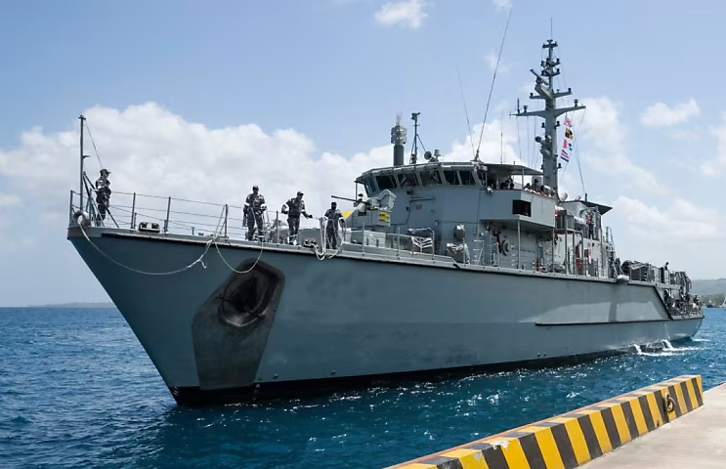
Ship Tactical System
Period: Aug 2023 – Dec 2024
Objective
The Ship Tactical System enable the Royal Australian Navy to provide peace keeping activities.
Role
ICT support & software engineering activities
Test Witness
Outcome
Created Windows standard operation environment.
All tests witnessed have passed without incidents.
Resolved network issue between corporate network and internal lab network.
Technology
Platforms : Windows 10
Languages : Windows batch & Powershell scripts
Tools : Clonezilla, WinPE, Windows 10, Solaris, Ubuntu

Slide 6
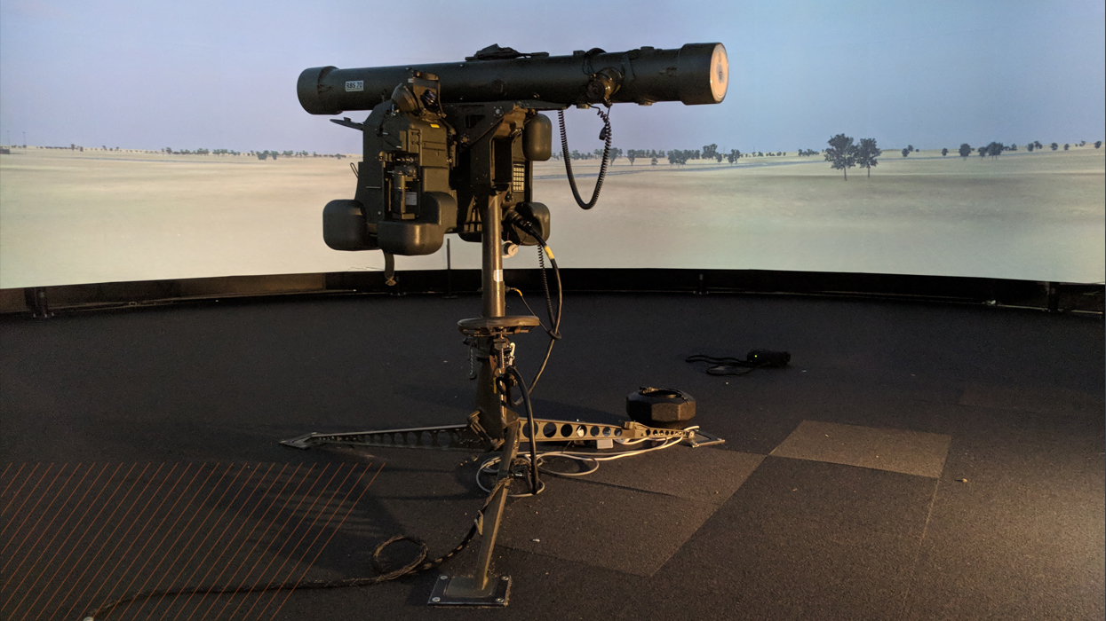
Air Defence Training System
Period: Aug 2022 - Current
Objective
The Air Defence Training System is a unique and innovative project that enables trainees to simulate air defence scenarios in diverse terrains and weather conditions, enhancing their skills and preparedness.
Role
ICT support
Software Engineering
Outcome
Fixed all reported bugs within the build release cycle.
Redesigned an automatic audiovisual recording subsystem following the SOLID principles.
Refactored C++ & C# code.
Software released according to schedule.
Technology
Platforms : Windows 95/7/8 VMs, Windows 10 Desktops and Linux Server
Languages : C++, C#, JavaScript, PHP, Powershell, and Unix shell scripts.
Tools : Visual Studio, Vi text editor, Wireshark, Open Broadcaster Software, Blender 3D modeller

Slide 7
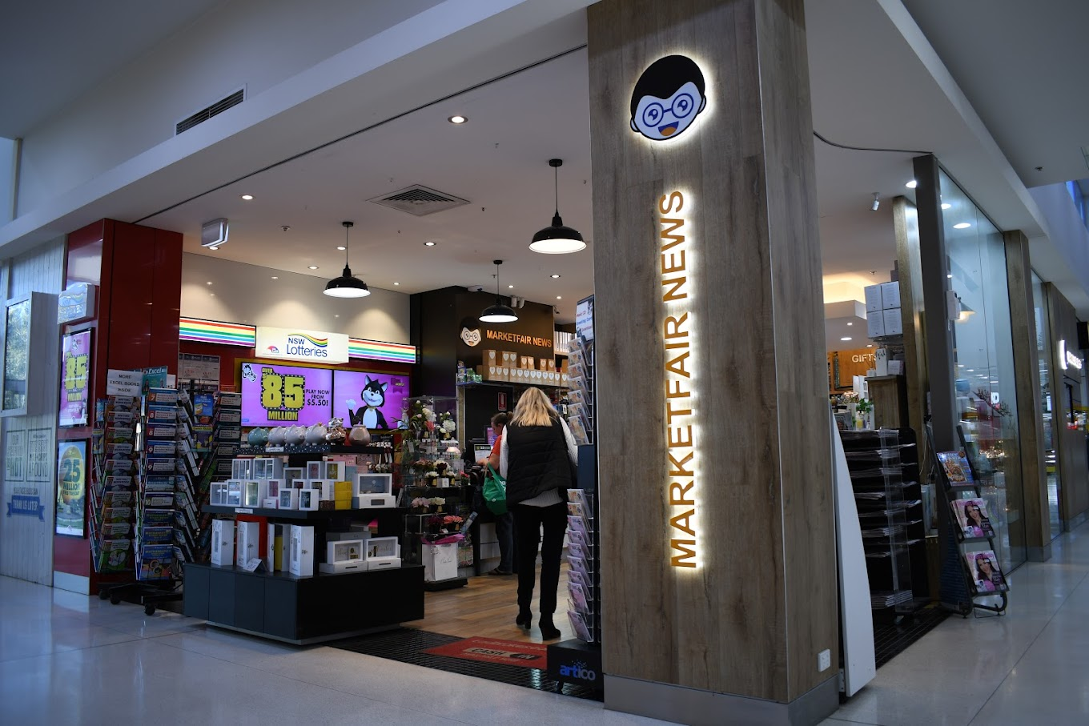
POS-to-eCommerce Integration
Period: Sep 2006 – Mar 2007
Objective
Enable near real-time update of inventory and prices from store’s POS to Woocommerce ecommerce store.
Role
Integrate propriety POS system with Open-Source online store.
Outcome
Online store contributed 12% of monthly revenue to the business.
Technology
Platforms : Linux, Windows
Languages : PHP, JavaScript.
Tools : Pentaho Data Integration, Cron, SQL
Databases : Microsoft SQL Server, PostgreSQL

Slide 8
New ERP Deployment
Period: Dec 2009 – Aug 2010
Objective
Replace the monolithic and antiquated legacy ERP system with a modern, in-house-developed ERP system. The new ERP system utilises Open-Source frameworks and sub-systems, including Linux and PostgreSQL.
Role
Provide operation and system expertise to the core development team.
Outcome
Saved hardware upgrade costs for over 600 users by implementing the deployment strategy to run the new ERP GUI on Windows, Linux or Solaris.
Enabled seamless transport operations to maintain steady business functions by developing the ERP Systems Integrator to synchronise live data between the two ERP systems
Technology
Platforms : Windows, Linux, Unix
Languages : JavaScript, bash shell script
Tools : Pentaho Data Integration
Databases : Ingres and PostgreSQL

Slide 9

Proof of Delivery Document Management System
Period: Feb 2009 – Jun 2009
Objective
Replace the legacy document management system that ran on Windows 95 and used Powerbuilder.
Role
Develop the system using Open-Source frameworks and sub-systems.
Outcome
Reduced operation time by more than 70%
Has the freedom to enhance - not locked into propriety systems
Customisable to business operations
Technology
Platforms : Linux, Windows
Languages : C++, Perl
Tools : Glade
Databases : PostgreSQL, Ingres
Libraries : Boost, POCO, Glib

Slide 10

Scan To Revenue System
Period: Jun 2008 – Sep 2008
Objective
Recover venue leakage for the freight business unit.
Role
Design and develop data cleaning and matching system to identify leaked revenue and invoice customers.
Outcome
Recovered $2 million p.a. in revenue leakage
Technology
Platforms : Linux, Windows, Solaris
Languages : SQL, C, JavaScript
Tools : Pentaho Data Integration
Databases : PostgreSQL, Ingres

Slide 11

IT Helpdesk system
Period: Sep 2007 – Nov 2007
Objective
Provide IT Helpdesk issue & requests submission, prioritisation and tracking.
Role
Implemented the system using Open-Source frameworks and sub-systems.
Outcome
Enabled internal customers to track progress of their requests at anytime.
Technology
Platform : Linux
Package : OTRS
Database : PostgreSQL

Slide 12
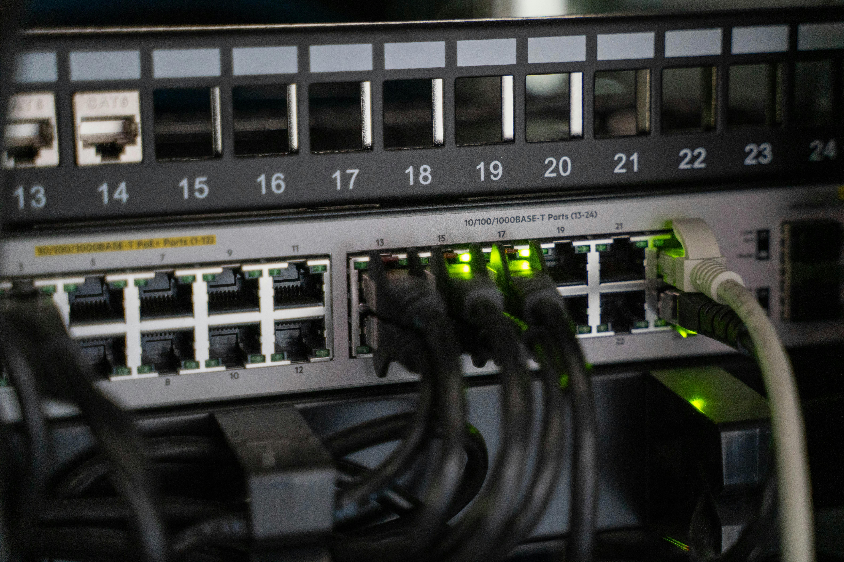
Service & Network Monitor System
Period: Aug 2007 – Nov 2007
Objective
Provide real-time systems and network monitoring and alert supporting technical staff.
Role
Implement the system using Open-Source frameworks and sub-systems.
Outcome
Eliminated IT labour for systems and network monitor
Increased time to resolution for systems and network issues
Technology
Platforms : Linux, Windows, Unix
Language : Unix shell scripts, C and C#
Package : Nagios

Slide 13
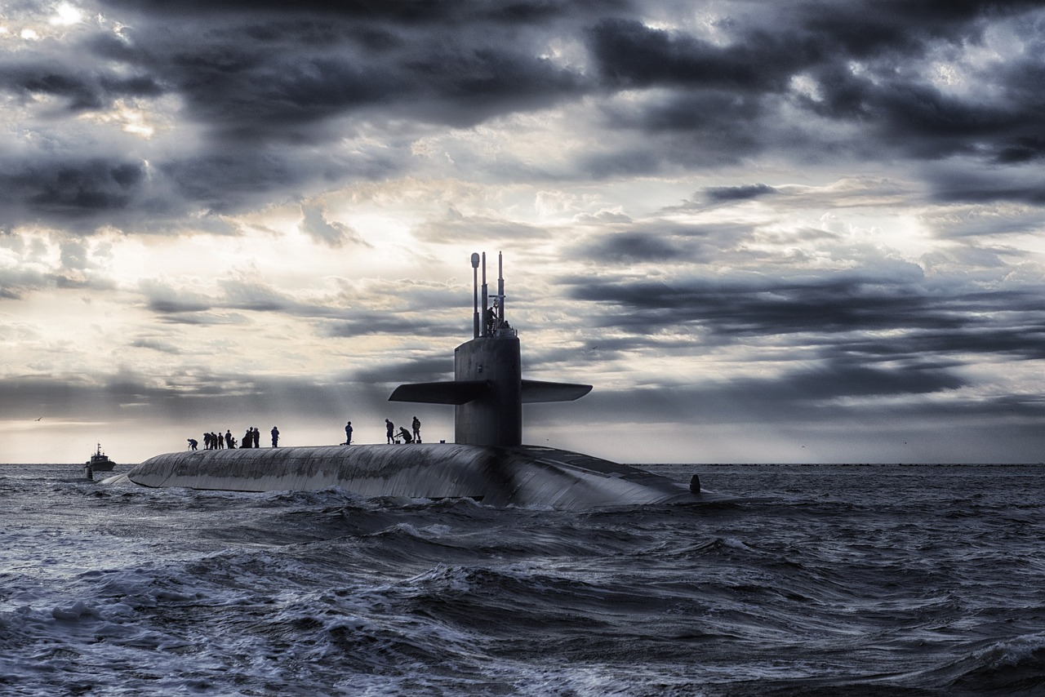
Submarine Combat System Training Software
Period: Mar 2002 – Jul 2002
Objective
Provide onshore training facility for the Collins Class Combat System.
Role
Design and implement the training system on the Windows operating system.
Outcome
Completed within the project schedule
Technology
Platform : Windows
Language : C++
Tool : Visual Studio
Library : Microsoft Foundation Class

Slide 14

Hard Disk Cloning Over TCP/IP
Period: Apr 2001 – June 2001
Objective
Provide an easy-to-use hard disk cloning over the network for the Collins Class submarine combat system.
Role
Design the system using message bus via TCP/IP.
Outcome
The software ran within the familiar combat system environment. Thus, the operator could clone the hard disks while the combat system was operating, reducing downtime.
Technology
Platform : Solaris
Language : Ada

Slide 15

Parcel Tracking System
Period: Jun 1999 – Dec 1999
Objective
Provide tracking of parcels within the distribution network.
Role
Design and develop the system within the constraints of the technology used by the company.
Outcome
Captured the parcel's transition between different parts of the distribution network. Allowing clear delivery progress.
Technology
Platforms : Windows, Unix
Languages : Powerbuilder, C, SQL
Databases : Ingres, Access database

Slide 16

Automatic Courier Delivery Booking System
Period: Aug 1997 – Mar 2001
Objective
Provide automatic courier delivery booking using EDI data from customers' systems.
Role
Designed and developed the system within the constraints of the technology used by the company.
Outcome
Secured new delivery service contracts generating $20 million p.a.
Authored the first EDI specification for the transport and logistics industry
Technology
Platform : AIX Unix, Digital Unix, Windows
Languages : SQL, C
Database : Ingres

Slide 17

How I Can Help You?
Email : robertqhbui@gmail.com
robert@robert.com
Website : robertbui.com

